Slide 1
Fixed Learning Session - Self inflicted & Defense injuries By Dr. Nirmala Perera
Computer Designing by Dr. Udara Senarathne

Slide 2

Objectives…
You should utilize this FLS to achieve the following;
Define above injuries
Identify above injuries by their features
Identify medico legal significance of those injuries

Slide 3
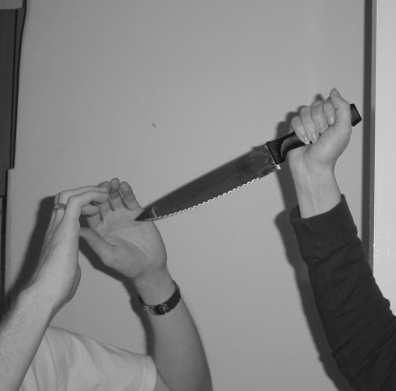
Defense injuries…
Defense is a natural reaction to protect oneself. Defense injuries are commonly seen in limbs since limbs are usually used for protection.

Slide 4
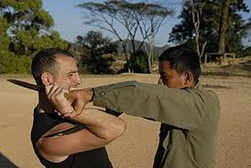
Case Scenario…
Medical Officer medico legal was summoned to a surgical unit to do medico-legal examination of a victim following an assault. Following photograph was taken during the examination.

Slide 5
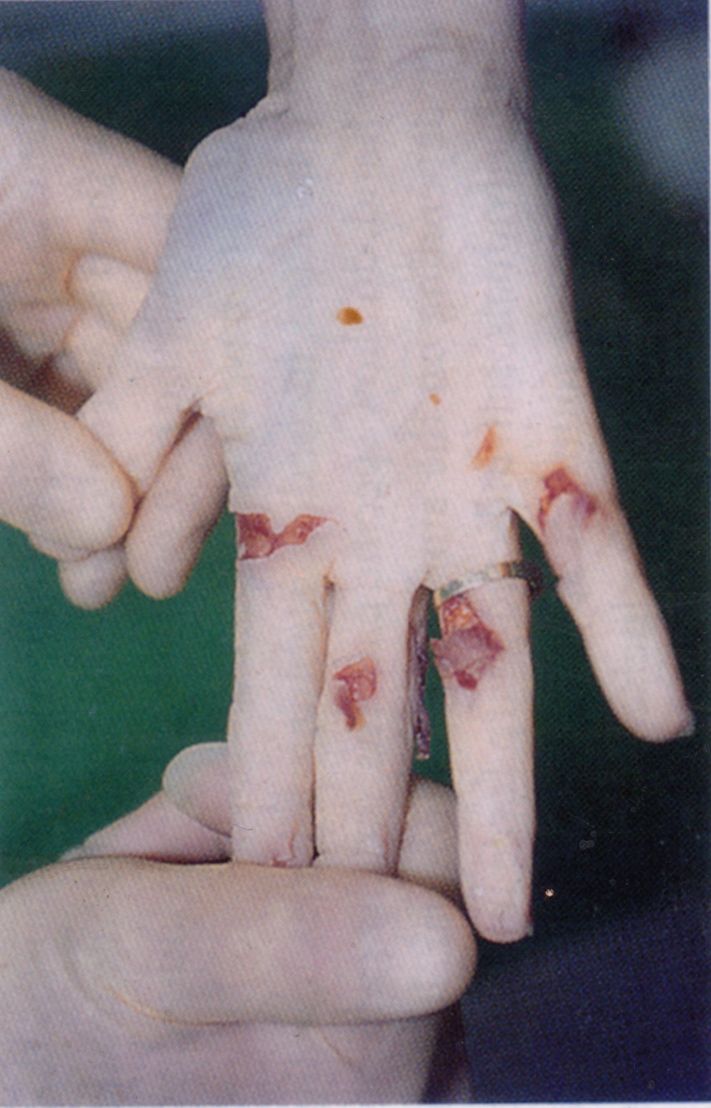
1. This is a photo of the right hand of the victim. Describe the injuries.

Slide 6
1. This is a photo of the right hand of the victim. Describe the injuries.
There are 4 incised injuries on the palmer aspect of the right hand. Injuries show clean cut margins with tissue tags. Underlying subcutaneous tissue can be seen with haemorrhages.

Slide 7
2. What is the possible causation of these injuries?

Slide 8
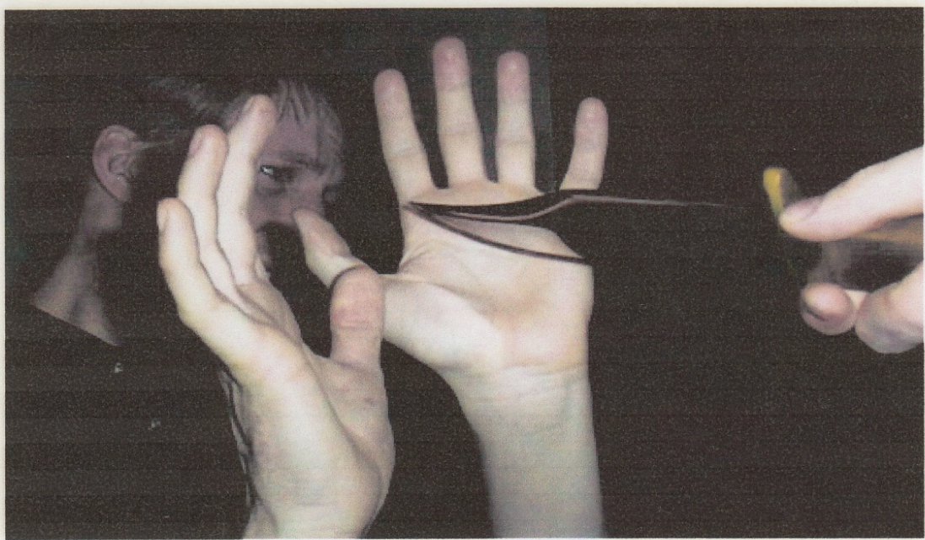
2. What is the possible causation of these injuries?
These injuries had been caused by grabbing a sharp weapon such as a knife while trying to defend an attack.

Slide 9

Defense injuries are caused by the natural reaction to protect against an unfriendly approach. Classical sites of defense injuries are forearms as in attempt to protect face and head, thighs as in attempt to protect genitals.

Slide 10
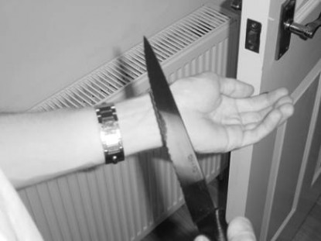
Self inflicted injuries….
They are found in cases of suicide, deliberate self harm and malingering.

Slide 11
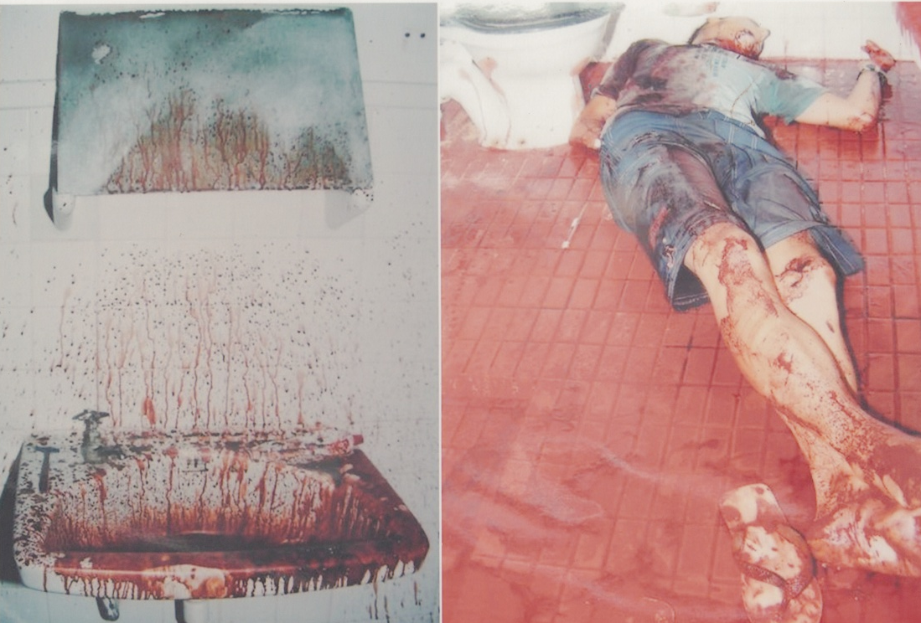
Case Scenario…
A 20 year old man was found dead in a bathroom of a hotel room . Body was brought to the hospital mortuary with the magistrate order.

Slide 12
1. Which of the following guide you to determine the circumstances of death as suicide? Mark true/false.
Hotel room was not locked.
Presence of suicidal note.
Absence of weapon.
Disturbed surroundings in the room.
Single fatal injury.
Stab injury over an accessible area.
Injury compatible with handedness.
Stab through clothing.
Answer

Slide 13
Answers…
Hotel room was not locked. (F) Usually rooms are locked from inside in cases of suicide.
Presence of suicidal note . (T)
Absence of weapon. (F) Weapon is found at the scene in a case of suicide.
Disturbed surroundings in the room. (F) Evidence of struggle indicates homicide
Single fatal injury. (T) More than one fatal injury indicates homicide.
Stab injury over an accessible area. (T)
Injury compatible with handedness. (T)
Stab through clothing. (F) Usually clothing is spared

Slide 14
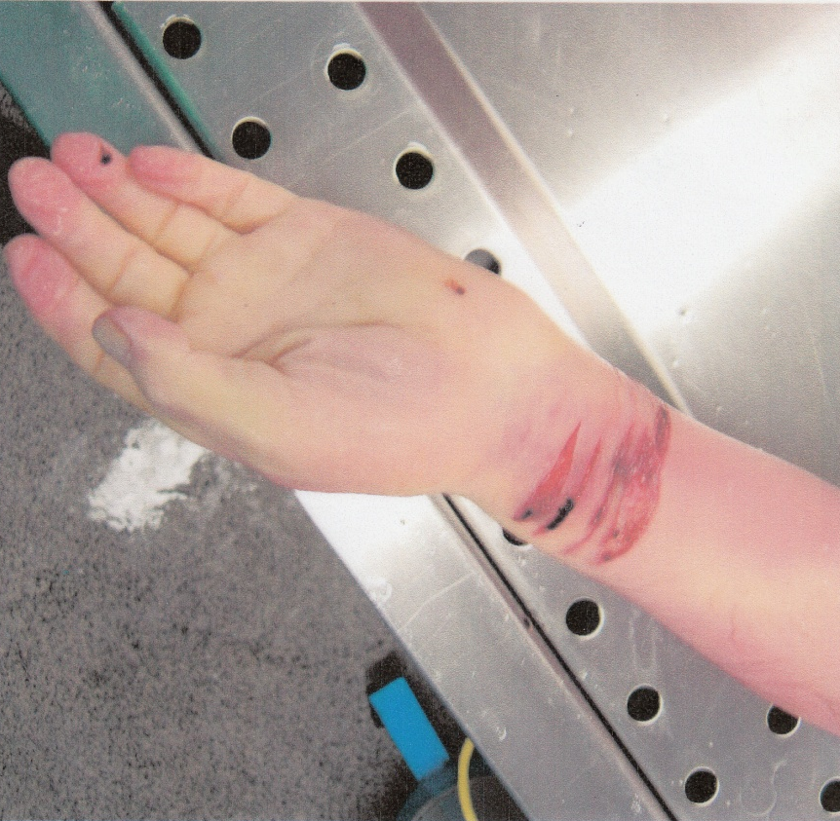
2. These injuries were seen on the left forearm of this person. Describe the injuries.

Slide 15
2. These injuries were seen on the left forearm of this person. Describe the injuries.
There are multiple, parallel, superficial incised wounds on the anterior aspect of the left forearm near the wrist.
They are linear and elliptical in shape.
Horizontally placed.
Margins are clearly cut.

Slide 16
3. State the medico-legal significance of these injuries .

Slide 17
3. State the medico-legal significance of these injuries .
Identification of the causative weapon as a sharp cutting weapon.
Circumstance of the injury - Multiple parallel superficial cuts indicate self inflicted injuries.
Dating of the injury – presence of bleeding indicates that the injuries were caused just before the death.
Event reconstruction – since this man had died of a suicide these injuries can be identified as hesitant marks which were caused before infliction of the fatal injury.

Slide 18
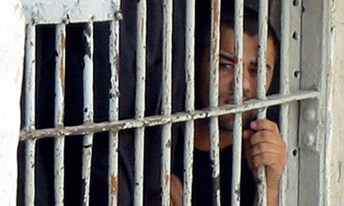
Case Scenario…
This 27 year old man was in the police custody for robbery and was produced before a JMO for medico-legal examination. In the history he accused a fellow prisoner who had been in the same cell as he for assaulting him with a blade. Further questioning reveled that he is right handed.

Slide 19
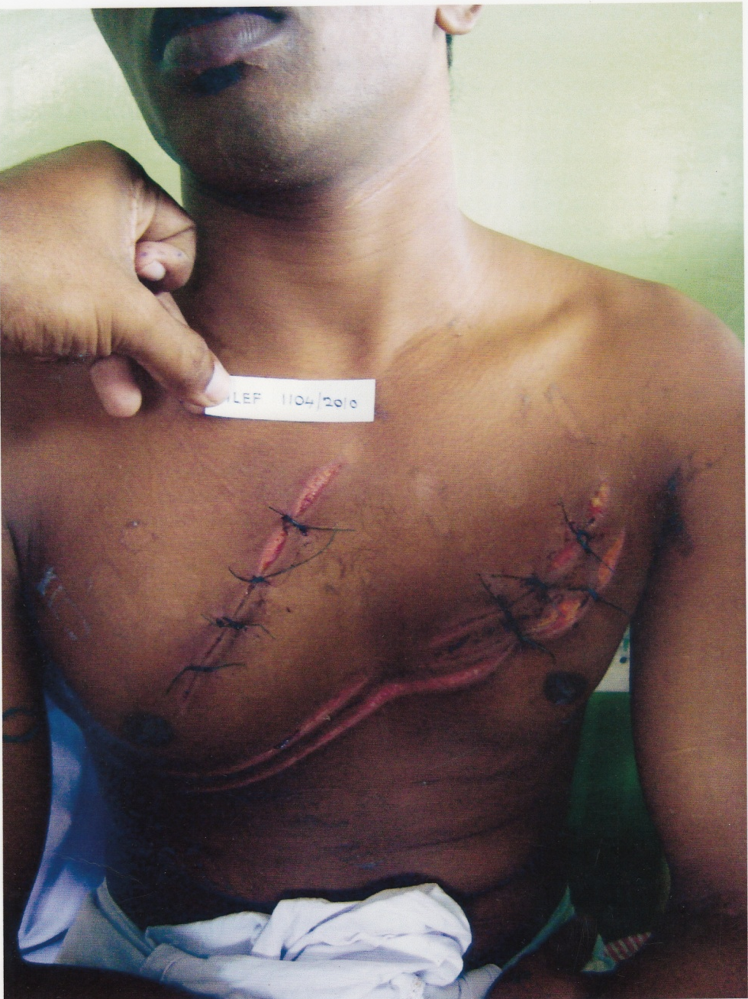
1. Describe the injuries seen in this photograph.

Slide 20
1. Describe the injuries seen in this photograph.
There are 3 cut injuries with cleanly cut margins placed on the upper anterior chest.
They are partially healed and sutures can be seen in upper part of all 3 injuries.
They are basically parallel and directed from the left upper aspect of the chest towards right lower aspect of the chest.
The cuts seem deeper at their upper ends and superficial in their lower ends.
They are regular and equal in depth.

Slide 21
2. After the examination the JMO stated his opinion as self inflicted injuries. What are the features that would help him to come to this conclusion.

Slide 22
2. After the examination the JMO stated his opinion as self inflicted injuries. What are the features that would help him to come to this conclusion.
Multiple, parallel superficial cuts with regular depth.
Avoidance of vital and sensitive areas.
Accessible site.
The direction of the injuries are compatible with the handedness of the examinee.
No defense injuries

Slide 23
Summary…
Self infliction of injuries could be suicidal in nature or due to a mental disorder or fabrication of injuries to simulate an assault.

Slide 24

Now can you?
Define self inflicted injury & defense injury
Identify above injuries by their features
Identify medico legal significance of these injuries

Slide 25
YES! You Can!

Slide 26

GOOD JOB!

